Slide 1


Major Project
Title:Detection of forged signatures
Presented by:
R134219050 - Jagdish
R134219053 - Kartik Garg
R134219035 – Devansh Khanna
Mentored By:
Keshav kaushik

Slide 2
Content
Introduction
Literature Review
Objectives
Methodology
References
Colour Code:
Synopsis: Red
Mid term: Orange
End Term: Purple
Note: The Following presentation will have all the content of the later.

Slide 3
Introduction
Offline signatures are significant today. Offline signature verification and forgery detection are complex and fraught with serious problems. The forging of signatures causes cooperating and commercial organizations to suffer substantial financial losses and damages their security reputation. Forgery is frequently observed in the banking industry since it involves sensitive information, official paperwork, and government regulations (LIC) that could be vulnerable to fraud and its effects.
Data protection
Security
Integrity maintained
Ensured compliance
Therefore, a system that can tell the difference between a real signature and a forgery is needed to reduce the likelihood of theft or fraud.

Slide 4
Literature Review
Cite Related work
SIGNATURE RECOGNITION AND FORGERY DETECTION
Every person has a distinctive signature primarily
used for personal identification and to confirm the authenticity
of important papers or legal transactions. Static and dynamic
signature verification are the two types available.
2. Offline Signature Recognition and Forgery Detection using Deep Learning
Authentication plays a very important role to manage security. In the modern era,
it is one, in all the priorities. With the appearance of technology, the interaction
with machines is turning automatic. Therefore, the need of authentication
increases rapidly for various security purposes.

Slide 5
SWOT analysis
STRENGTH: An online signature system recognizes the action of the pen while signing, and these signatures can be validated depending on several factors, including pen pressure and writing speed. These characteristics are unique and difficult to forge.
WEAKNESS:Limited data: The availability of data for signature forgery detection can be limited, which may impact the accuracy of the system.
Costly: Developing a robust signature forgery detection system can be expensive, especially in terms of acquiring data and computational resources.
OPPORTUNITY: Signature forgery detection software can greatly improve efficiency in sectors that deal with a large volume of paper works that involve signatures. It saves time and effort and eliminates fraudulent practices to a great extent.
THREATS: Data poisoning: Attackers may attempt to inject fake or manipulated data into the system to train it incorrectly or to bias its outputs, leading to incorrect detections.
False positives/negatives: The system may incorrectly identify a genuine signature as a forgery or vice versa, leading to the wrong decision or result.

Slide 6
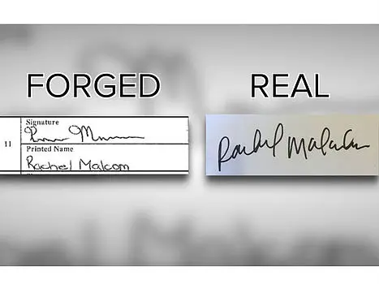
Objective
Main Objective
It is necessary to create an intelligent system that can quickly identify different kinds of forgeries. The objective of the software is to verify if a given signature is original or forged and to understand the characteristics of a signature.Therefore, with the growing demand for protection of individual identity, the design of an automatic signature system is needed.

Slide 7
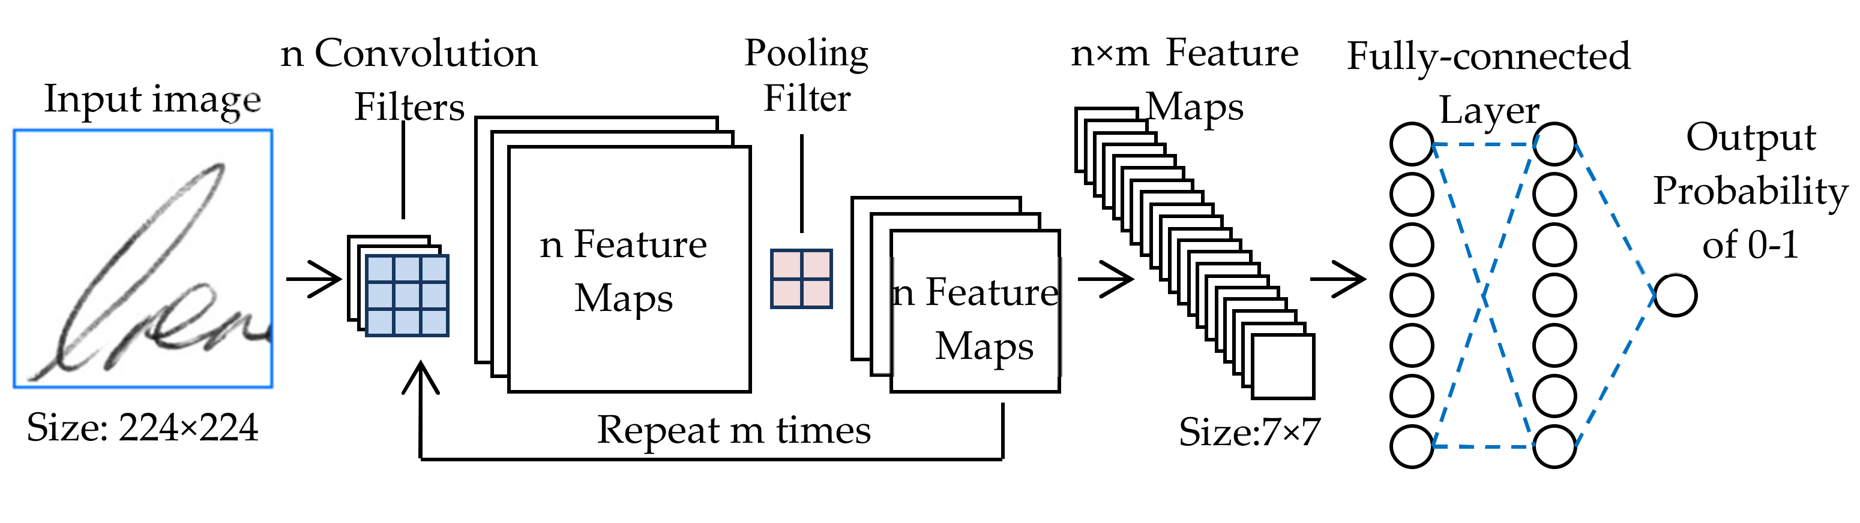
Methodology
Reference Software model
The four-stage technique used by the verification system is
Data Pre-processing, Feature Extraction, Model Training,
and Model Testing.

Slide 8
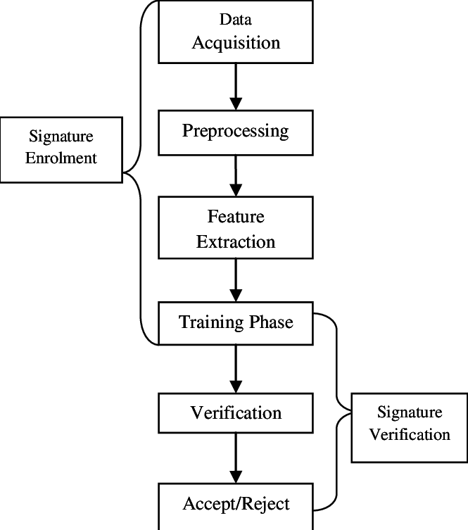
Working Model
Requirement analysis
Technical Diagram
Working Module
Attained Deliverable

Slide 9
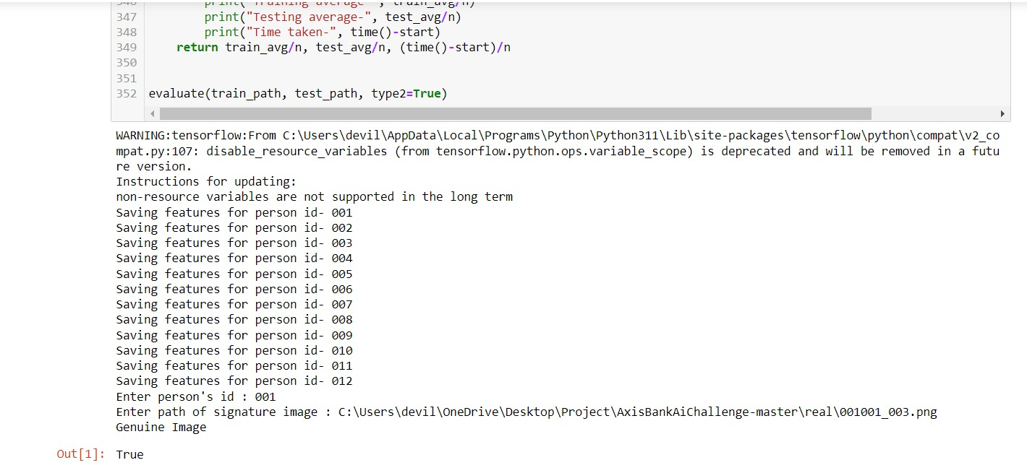
Results

Slide 10
Conclusion
The project scope for detection of forged signatures may include the following points:
Developing a dataset: Collecting and developing a diverse dataset of genuine and forged signatures to be used for training and testing the algorithm.
Signature extraction and pre-processing: Developing a method to extract relevant features from the signature, such as stroke width, pressure, and direction, and pre-processing the signature images to remove noise and distortions.
Algorithm development: Developing a machine learning or deep learning algorithm that can analyze the extracted features to detect forged signatures accurately and efficiently.
Performance evaluation: Evaluating the performance of the developed algorithm using standard evaluation metrics such as accuracy, precision, recall, and F1 score.
Integration with existing systems: Integrating the algorithm with existing signature verification systems, such as biometric authentication systems, to enhance their accuracy and reliability.

Slide 11

Reference
B: List of cited papers
https://www.techrxiv.org/articles/preprint/SIGNATURE_RECOGNITION_AND_FORGERY_DETECTION/21293121/1/files/37776993.pdf
https://www.researchgate.net/publication/4153574_Signature_Verification_and_Forgery_Detection_System

Slide 12
Thank You

